Slide 1
Goal
In statistics, a full factorial experiment is like mixing and matching different ingredients to see how they affect the outcome.
Imagine you're baking a cake, and you want to know how the amount of flour and sugar affects its taste.
A full factorial experiment would involve trying every possible combination of flour and sugar amounts to see what happens.

Slide 2
What we interested in
Usually, each ingredient (or "factor") has just two levels, like "more flour" or "less flour." So, if you're testing two factors, you'd end up with four different combinations: more flour and more sugar, more flour and less sugar, less flour and more sugar, and less flour and less sugar.
Now, here's the trick: we also want to see how these ingredients interact with each other. Maybe adding more flour makes the cake taste better, but only if you also add more sugar. That's what we call an interaction.

Slide 3
Data structure
The data structure of the factorial design depends on the scientific question you are interested in.
Three different models and their corresponding data structures will be introduced in the following slides.

Slide 4
Data structure
If we are only interested in the main effects of two factors, we must perform the experiment with at least 2 levels for each factor.

Slide 5
Evaluate the effect

Slide 6
Evaluate the effect

Slide 7
Evaluate the effect
Hence, a full two-factorial design can be regarded as a specific instance of a randomized complete block design (RCBD) when considering both treatments and blocks at two levels.
Remark: there is no free degree of freedom to estimate the interaction and block effect.

Slide 8
Data structure
If we are interested not only in the main effects of two factors but also their interaction, we must perform the experiment with at least 2 levels for each factor, and each level must have at least 2 replications (iid).

Slide 9
Evaluate the effect

Slide 10
Evaluate the effect

Slide 11
Partition sum of square

Slide 12
Nonparametric method of RCD

Slide 13
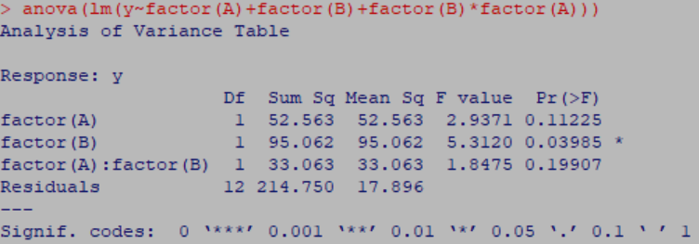



y=c(16,17,18,15,18,14,12,14,32,24,20,16,20,16,15,10)
B=c(0,0,0,0,1,1,1,1,0,0,0,0,1,1,1,1)
A=rep(c(0,1),each=8)
anova(lm(y~factor(A)+factor(B)+factor(B)*factor(A)))
yM=matrix(y,4,4,byrow=T)
AB=matrix(apply(yM,1,sum),2,2,byrow=T)
AB_i=apply(AB,1,sum)
AB_j=apply(AB,2,sum)
Xdd=sum(AB)
SSA=sum(AB_i^2)/8-Xdd^2/16
SSB=sum(AB_j^2)/8-Xdd^2/16
SSt=sum(AB^2/4)-Xdd^2/16
SSAB=SSt-SSA-SSB
SST=sum(y^2)-Xdd^2/16
SSE=SST-SSt

Slide 14
Treatment with block
To comprehensively explore the main effects of two factors and their interaction, conducting the experiment with a minimum of two levels for each factor is crucial. Moreover, ensuring that each level is replicated at least twice is essential. In the event that the replications do not exhibit identical means but demonstrate homogeneity in variance.
It appears that a block effect emerges when there are differing means among replications.

Slide 15
Evaluate the effect

Slide 16
Evaluate the effect

Slide 17
Partition sum of square

Slide 18
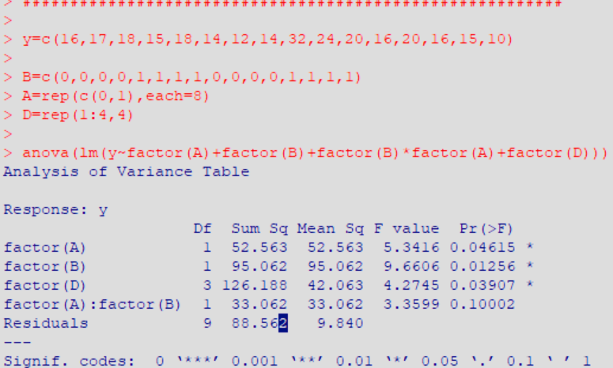
Nonparametric method of RCD

